Slide 1
Sales market of Bernardo
Azadeh MOJARAD POHIER
WildCodeSchool
Novebre 2022

Slide 2
Objective:
1. Exploratory descriptive analysis (EDA)
Seasonalities, Products
2. Find the corresponding store
Bourdeaux, Lille, Lyon Marseille
3. Explanation of the impact of the weather
Correlation between sales and weather
4. Sales forecasts
Predicting his stock for next week,

Slide 3
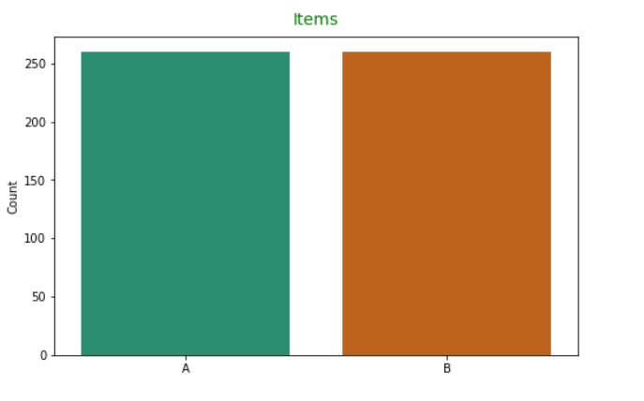
EDA:
Number of Items in the dataset:

Slide 4
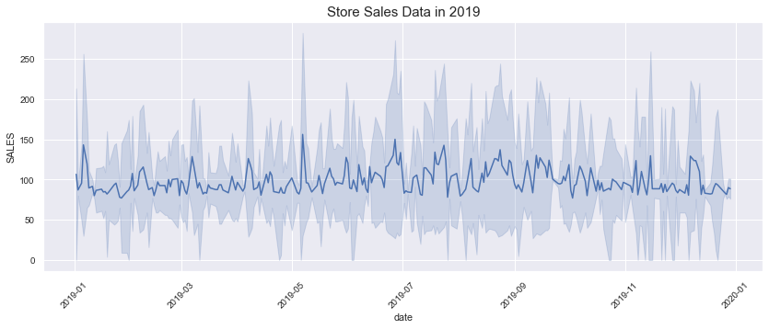
EDA:

Slide 5
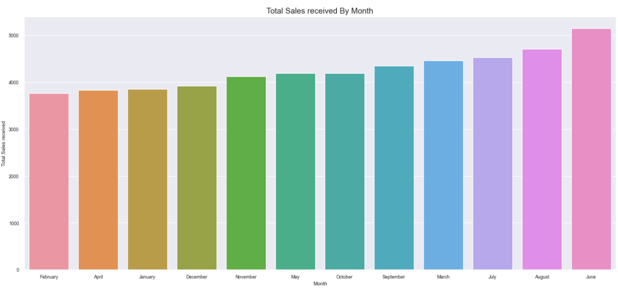
EDA:
Most sale in Jun, Aug & Jul

Slide 6
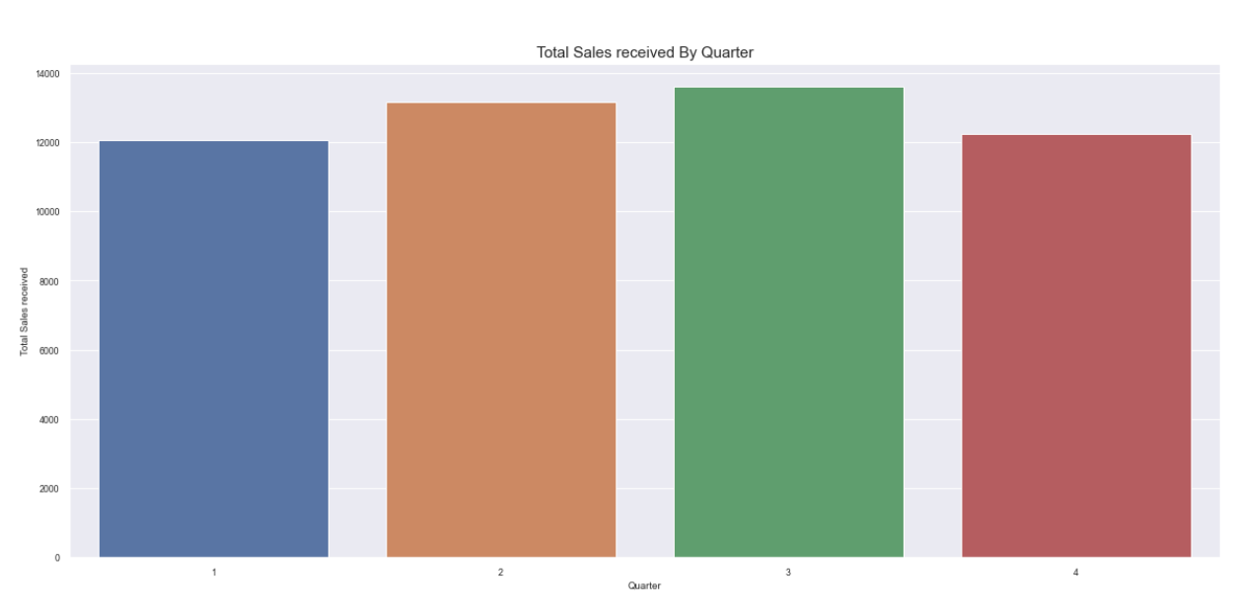
EDA:
1: Jan , Fev Mar
2: Apr, May, Jun
3: Jul, Aug, Sep
4: Oct, Nov, Dec

Slide 7
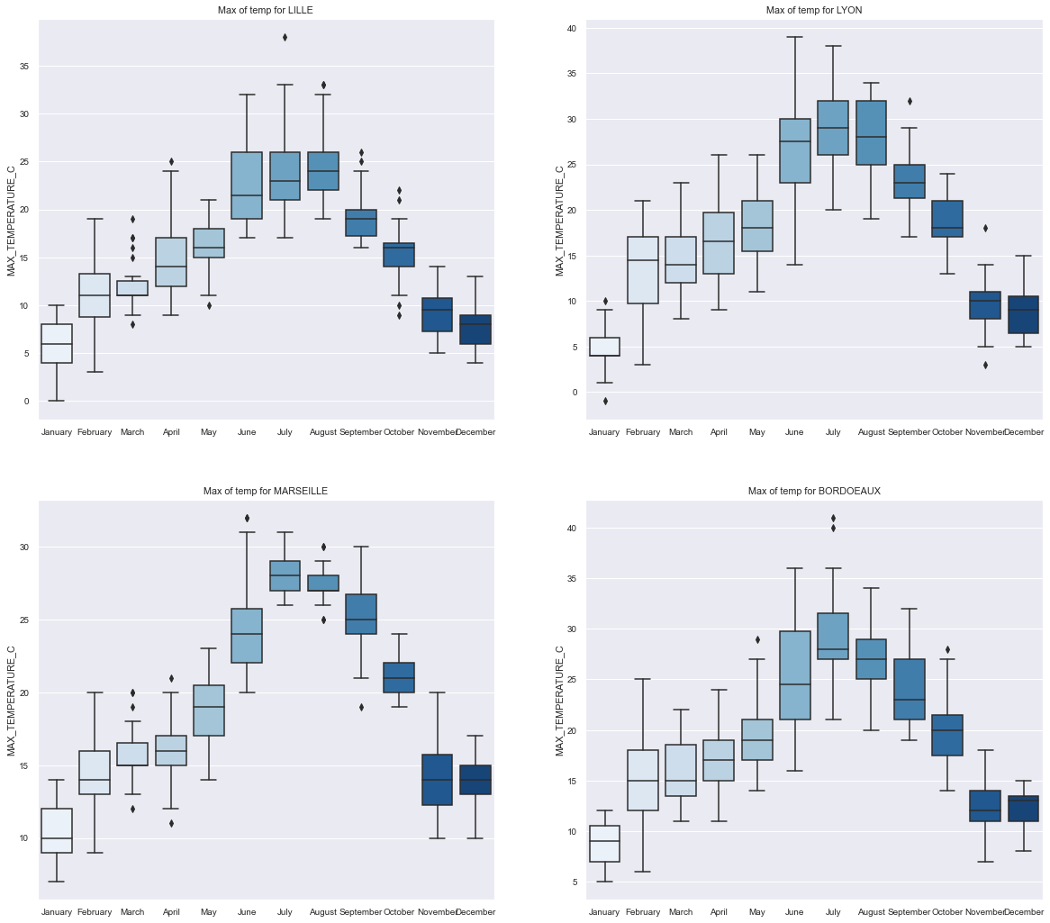
EDA:
MAX_TEMPERATURE
Of the cities:

Slide 8
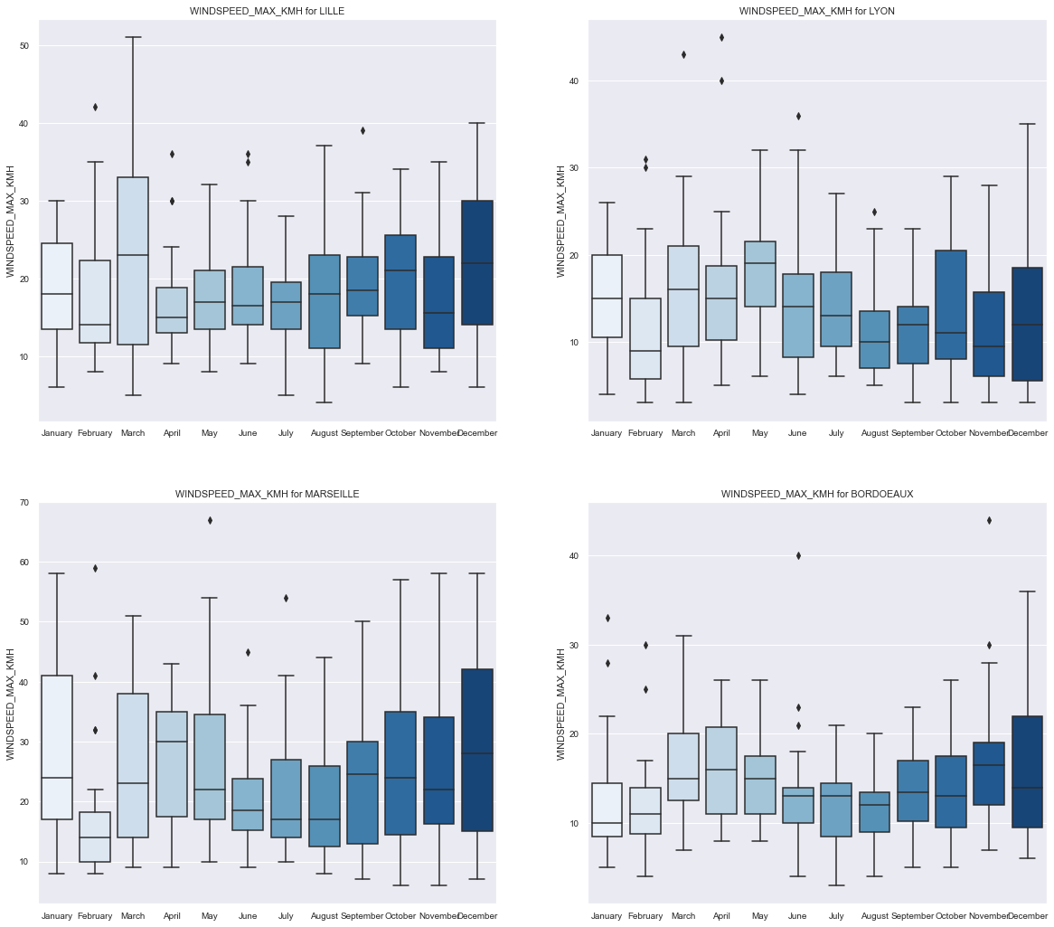
EDA:
WINDSPEED_MAX_KMH Of the cities:

Slide 9
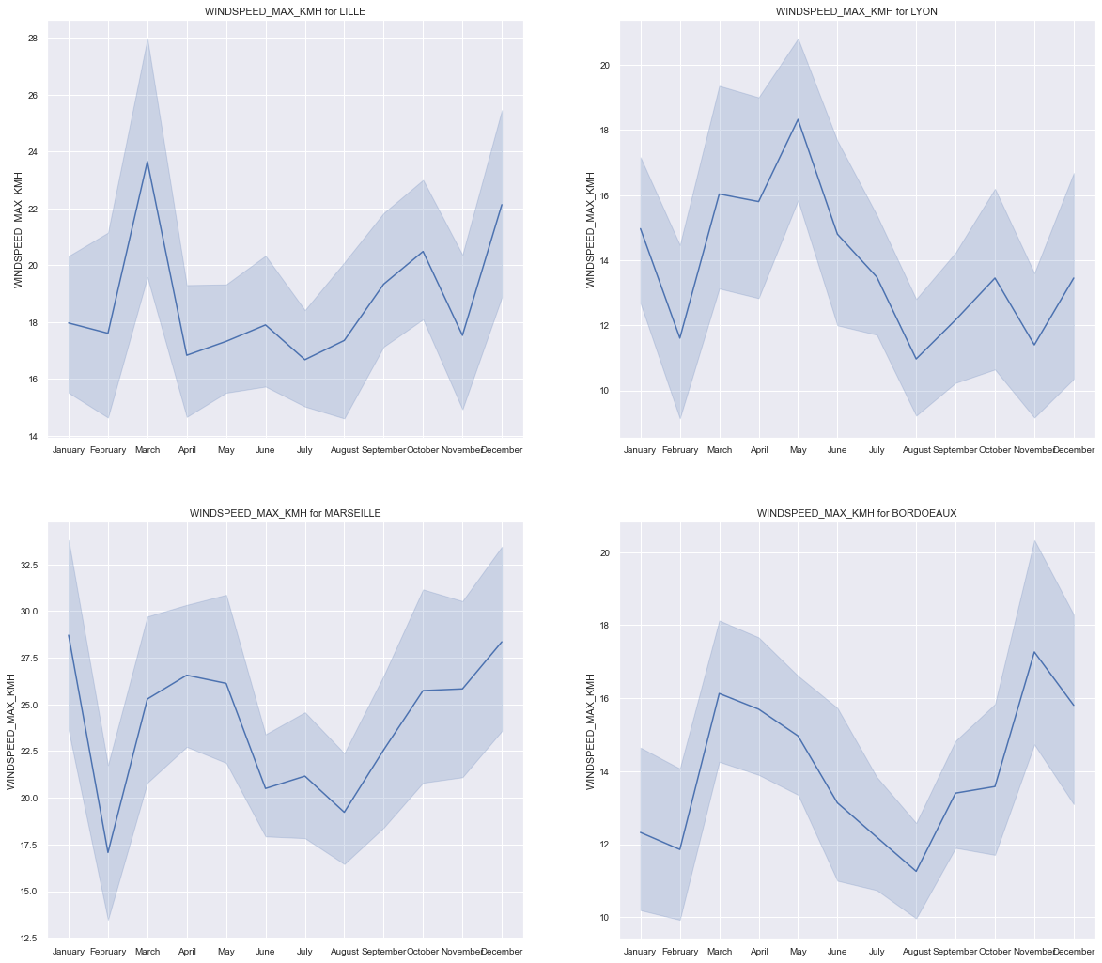
EDA:
WINDSPEED_MAX_KMH for 4 cities:
Most sales was in Jun, Jul, Aug, sep , Oct, May,….
MARSEILLE is close to our dataset.

Slide 10
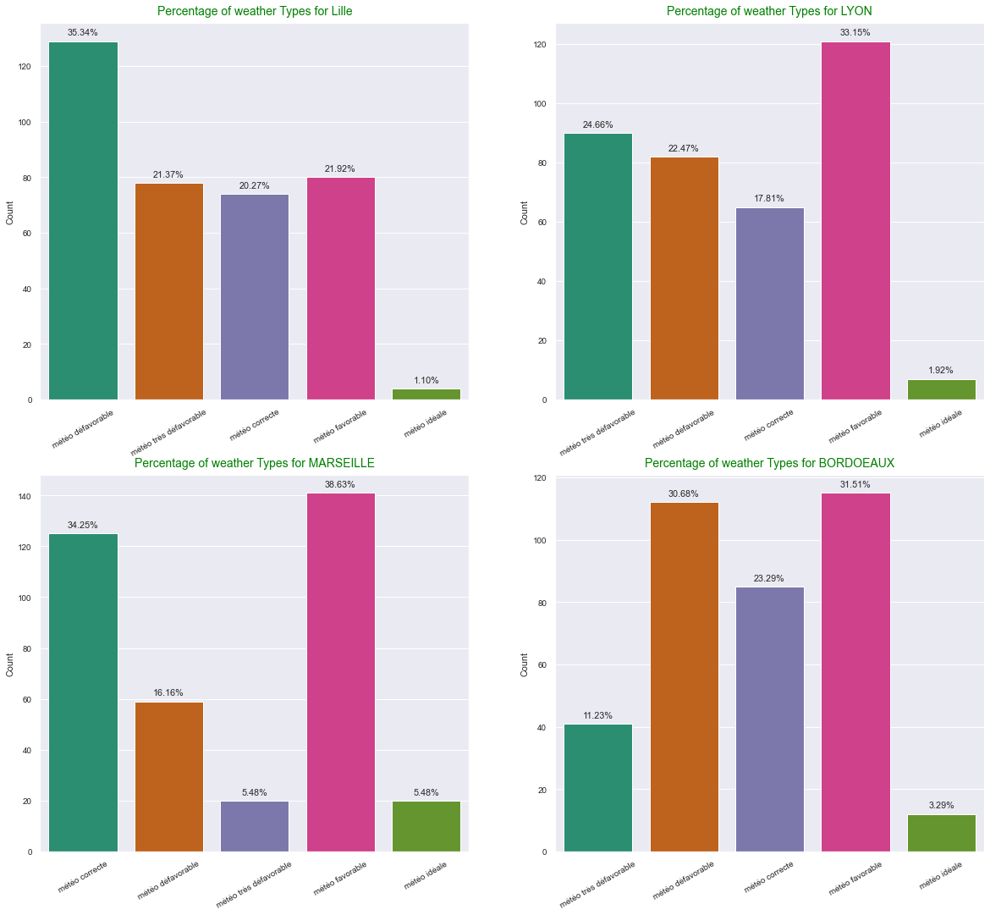
EDA:
Percentage of weather Types by opinion:

Slide 11
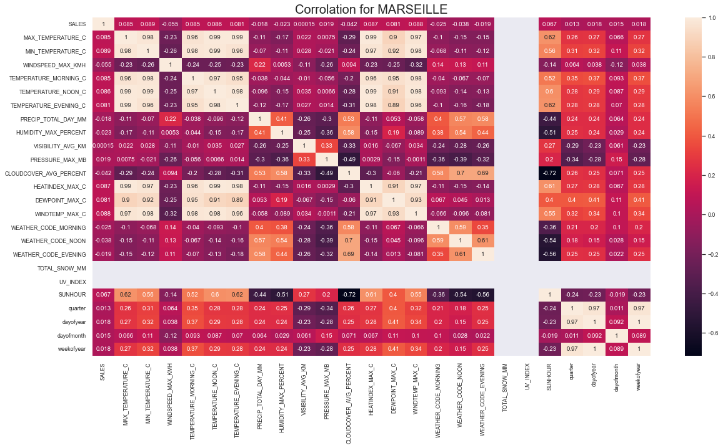
Corr:

Slide 12
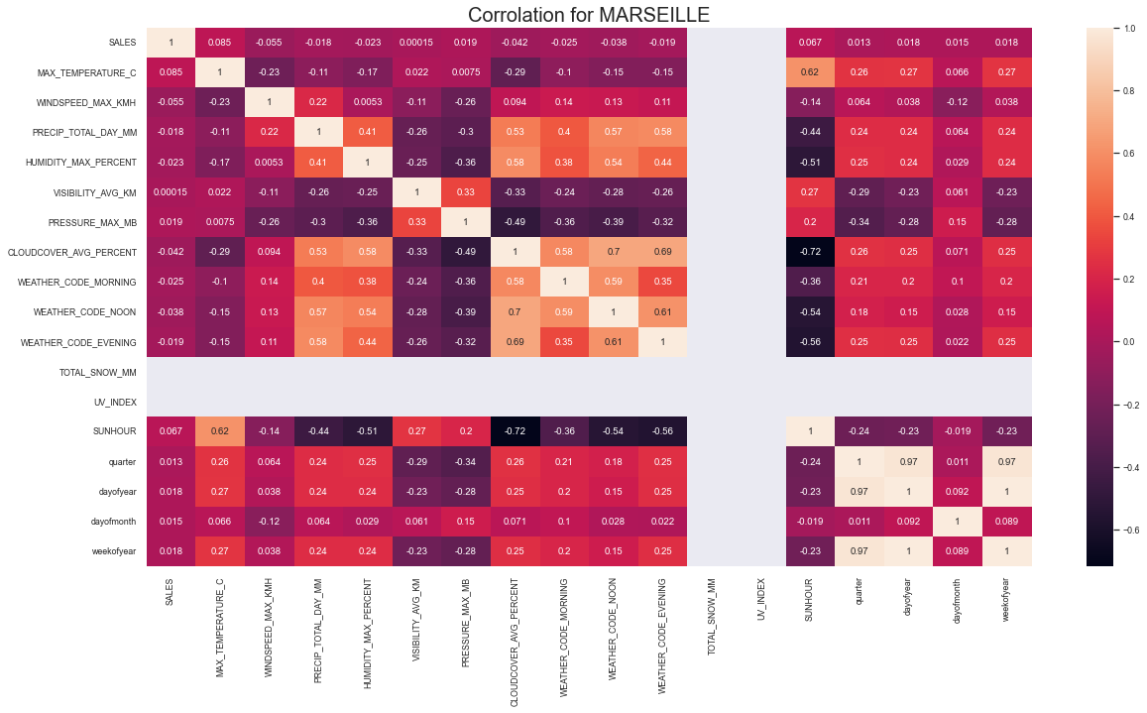
Corr:

Slide 13
Type of models:
Supervised & regression problem:
Random forest model
Gradient boosting
Support vector machine
Extra tree regressor
Finding hyper parameter by gridSearchCV

Slide 14
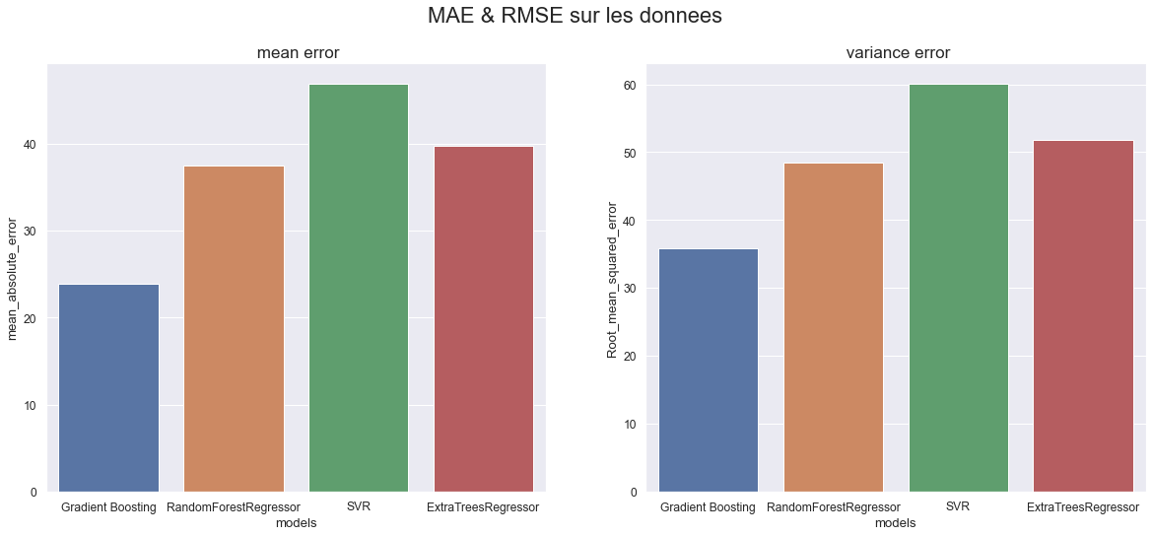
ML:
Gboosting is selected

Slide 15
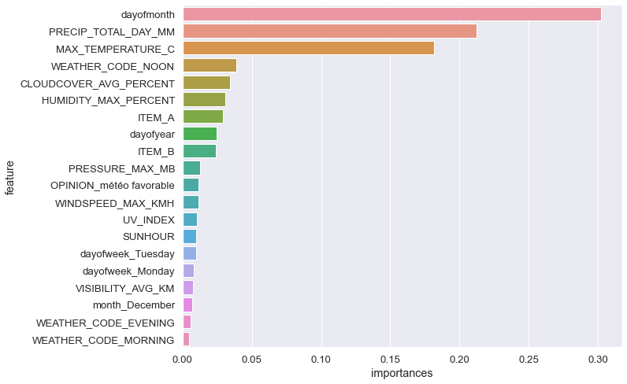
Feature importance:

